Slide 1

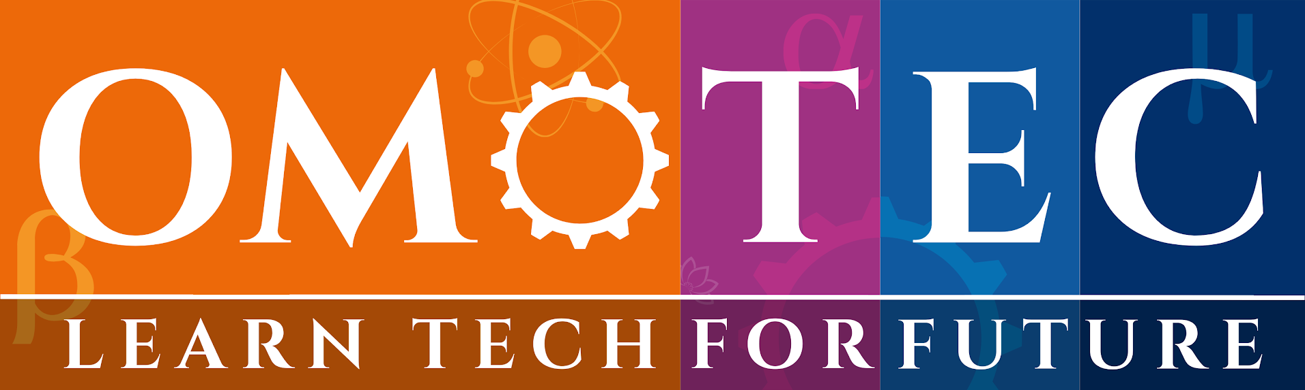
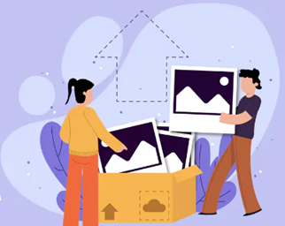

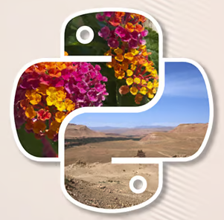
Session 1 :
Recap of Image Processing Level 1

Slide 2

Introduction to Image Processing
Image processing enhances visual information for human and machine understanding by applying mathematical operations to image data.
An image is a grid of pixels, each storing color or intensity data that the computer interprets as visual content.
Pixels are the smallest units of an image (often 8-bit values) and contain color or grayscale information.
Human vision interprets shapes, light, and motion intuitively, making decisions based on years of evolution and experience.
Computer vision analyzes images numerically, relying on algorithms to identify patterns and structures.
Digital images consist of matrices of pixel values, which can be analyzed using linear algebra techniques.
RGB pixels combine Red, Green, and Blue lights to create a wide range of colors.
Image processing is used in surveillance, medicine, automotive, and AI systems for
decision-making and automation.

Slide 3

Real-Time Example - Image Processing
CCTV cameras enhance night-time footage using filters and contrast adjustments for better visibility.
AI-powered medical scan analysis detects anomalies like tumors by analyzing MRI or CT scan images.
Barcode scanning in supermarkets uses image thresholding to read product codes.
Satellite image analysis for climate monitoring uses multi-spectral images to track changes in vegetation and land.
Filtering photos using mobile apps involves applying edge detection
and color adjustments to enhance pictures.

Slide 4

Introduction to OpenCV and NumPy
OpenCV is a powerful image processing library that provides functions for real-time computer vision applications.
NumPy handles numerical data efficiently and allows manipulation of image data as arrays.
OpenCV functions like imshow, imread, waitKey, and destroyAllWindows help load, display, and close image windows.
Easy installation through pip enables quick setup with pip install opencv-python numpy.
OpenCV is used for real-time vision in robotics, face detection, and object tracking systems.
Grayscale conversion and image loading basics form the foundation for preprocessing in image pipelines.
OpenCV provides matrix manipulations, thresholding, filtering, and drawing functionalities for building applications.

Slide 5

Real-Time Example - OpenCV & NumPy
Face detection in Zoom or Google Meet uses Haar cascades or deep learning models via OpenCV.
Lane detection in self-driving cars identifies lane lines using edge detection and perspective transforms.
Live filters in Snapchat or Instagram apply facial landmarks and effects using NumPy and OpenCV.
Thermal camera readings in drones are interpreted using color maps and NumPy matrix processing.

Slide 6

Understanding Digital Images
A digital image is a matrix of pixel values where each pixel represents color or brightness intensity.
The RGB model is used for color images, with values ranging from 0 to 255 for each color channel.
Grayscale images are 2D arrays, while color images are 3D arrays with Red, Green, and Blue channels.
The Average method for grayscale averages all color channels; Luminosity weighs them based on human sensitivity.
Black is represented as (0,0,0) while White is (255,255,255) in RGB.
Every pixel is a tiny light dot that collectively forms the complete visual.

Slide 7
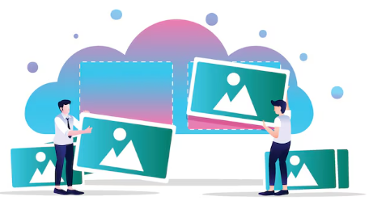
Real-Time Example - Digital Images
Scanning QR codes involves reading the black and white matrix using thresholding.
Color detection in industrial sorting systems separates products by color using pixel values.
Biometric recognition systems analyze pixel patterns in facial features or fingerprints.
Filtering noise in CCTV footage helps clarify moving objects by analyzing pixel consistency.

Slide 8

Image Formats and Metadata
Raster formats like JPG and PNG use pixels, while vector formats like SVG and AI use paths.
JPEG uses lossy compression which reduces file size by removing some data.
PNG uses lossless compression, preserving every detail of the original image.
EXIF metadata stores information such as camera settings, date, and GPS coordinates.
The Pillow library in Python is used to view and modify image metadata.
Choosing the right format impacts the image quality and loading speed.
Metadata helps organize large datasets, especially in photography and machine learning.

Slide 9

Real-Time Example - Image Metadata
Reading GPS coordinates from travel photos allows for geo-tagging and location-based sorting.
Forensics experts use image metadata to find tampered timestamps or editing traces.
JPEG compression is used to load web images faster while maintaining visual quality.
Watermarking images with metadata helps in ownership and copyright claims.

Slide 10

Loading and Displaying Images
cv2.imread() is used to load an image from a file into a NumPy array.
cv2.imshow() opens a window to display the image on screen.
cv2.imwrite() saves a modified image back to disk.
Image arrays represent intensity levels that the computer can manipulate.
cv2.waitKey() waits for a key press to close image windows safely.
Image formats supported include .jpg, .png, .bmp, among others.

Slide 11

Real-Time Example - Loading/Displaying
Image viewer software allows users to quickly open and view images.
Batch resizing tools process multiple images for consistent web upload sizes.
Automatic format converters turn .png images into .jpg and vice versa.
AI tools scan loaded images for features like labels or barcodes.

Slide 12
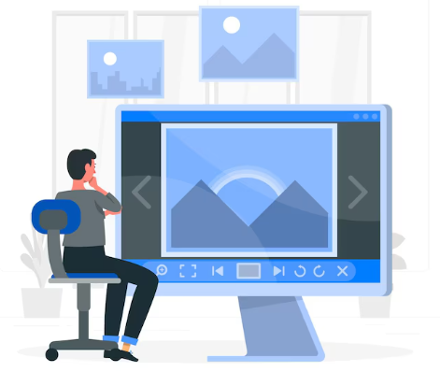
Understanding Color Models
RGB is used in screens and defines color through Red, Green, and Blue light intensities.
CMYK is used in printing where Cyan, Magenta, Yellow, and Black mix to form colors.
HSV separates Hue, Saturation, and Value to simplify color filtering.
Grayscale reduces the image to a single channel of brightness.
YUV is used in video encoding to separate luminance and chrominance.
The RGB model adds light while CMYK subtracts it to form colors.

Slide 13

Real-Time Example - Color Models
Green-screen removal in video editing uses HSV color thresholds to isolate backgrounds.
Color-based tracking in sports broadcasting follows jersey colors using HSV.
Skin tone detection in beauty apps is achieved by detecting specific HSV or YCrCb values.
CMYK color models are used in magazines and professional brochures for accurate printing.

Slide 14
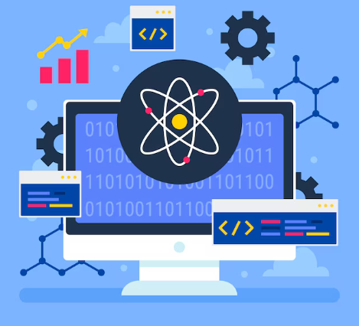
Image Manipulation - Brightness & Contrast
Brightness adjustments add or subtract values from all pixels.
Contrast changes the difference between dark and bright regions of the image.
cv2.convertScaleAbs() can adjust brightness and contrast linearly.
Trackbars allow real-time tweaking of these parameters during display.
Adjustments improve clarity in underexposed or overexposed images.

Slide 15

Real-Time Example - Brightness/Contrast
Enhancing dark security footage allows better recognition of faces or objects.
Retouching faded photos brings back lost details.
Smartphone cameras automatically adjust brightness and contrast in real-time.
Medical imaging uses contrast enhancement to highlight problem areas in scans.

Slide 16

Applying Filters
Gaussian blur smoothens an image by averaging pixel values.
Edge detection with Canny identifies boundaries and object outlines.
Sharpening brings out fine details by enhancing edges.
Filters help prepare images for further processing like contour or shape detection.
Noise removal using median filters to smooth small artifacts.

Slide 17

Real-Time Example - Filters
License plate recognition systems use edge detection to isolate characters.
Artistic photo editors apply cartoon and oil paint effects using OpenCV.
Portrait apps use filters to reduce blemishes and wrinkles.
Lane detection algorithms apply Canny edge detection for road analysis.

Slide 18
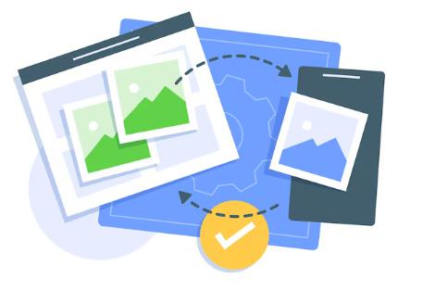
Drawing on Images
OpenCV lets you draw lines, rectangles, circles on images.
Drawing is useful for annotating detected objects or areas of interest.
Text labels can be added with cv2.putText().
Coordinates are used to specify where and what to draw.
Drawing functions aid debugging during computer vision development.

Slide 19
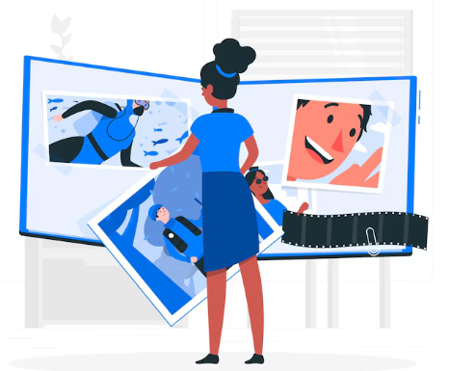
Real-Time Example - Drawing
Surveillance software draws bounding boxes around detected people.
Medical imaging overlays outlines of tumors or areas of concern.
Traffic management systems label lanes, vehicles, and stop signs.
Object detection models draw boxes and labels for identified objects.

Slide 20

Resizing and Cropping Images
cv2.resize() resizes images to desired dimensions.
Maintaining aspect ratio avoids stretching or distortion.
Cropping extracts specific areas using NumPy slicing.
Used to reduce image size for faster processing.
Crucial step in preparing images for AI and ML training.

Slide 21

Real-Time Example - Resize/Crop
Thumbnails for YouTube are created by resizing video frames.
Instagram auto-crops posts to standard dimensions.
AI image models require cropped faces or objects for better accuracy.
Apps like Zoom use face cropping to center participants in frames.

Slide 22
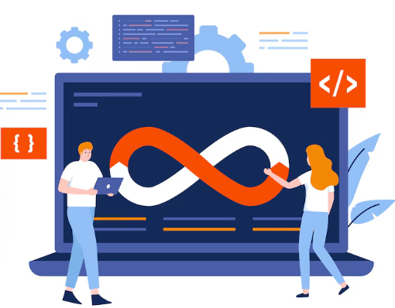
Python Code :
Brightness Control
Hands on Code to add brightness control to grayscale images.
Python script using OpenCV to add brightness control to a grayscale image using a trackbar for interactive adjustment.

Slide 23
Python script using OpenCV to add brightness control to a grayscale image using a trackbar for interactive adjustment
How It Works:
Load & Convert:
Reads an image and converts it to grayscale.
Brightness Adjustment:
Uses a trackbar (range: 0 to 200) centered at 100 (no change).
Values <100 decrease brightness, >100 increase it.
np.clip() ensures pixel values stay within 0-255.
Interactive Control:
Move the trackbar to see real-time changes.

Slide 24
import cv2
import numpy as np
def adjust_brightness(value):
"""Callback function for trackbar to adjust brightness"""
global gray_image, brightness
brightness = value - 100 # Center at 0 (range: -100 to +100)
adjusted = np.clip(gray_image.astype(np.int16) + brightness, 0, 255).astype(np.uint8)
cv2.imshow('Brightness Control', adjusted)
# Load image and convert to grayscale
image = cv2.imread('input.jpg') # Replace with your image path
gray_image = cv2.cvtColor(image, cv2.COLOR_BGR2GRAY)

Slide 25
# Create a window with a trackbar
cv2.namedWindow('Brightness Control')
cv2.createTrackbar('Brightness', 'Brightness Control', 100, 200, adjust_brightness) # Default: 100
(brightness=0)
# Initial display
cv2.imshow('Brightness Control', gray_image)
cv2.waitKey(0)
cv2.destroyAllWindows()

Slide 26
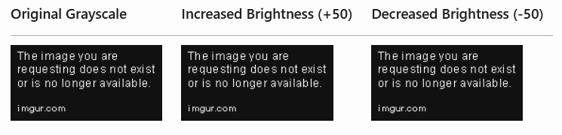
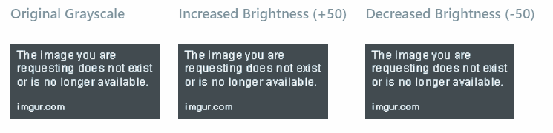
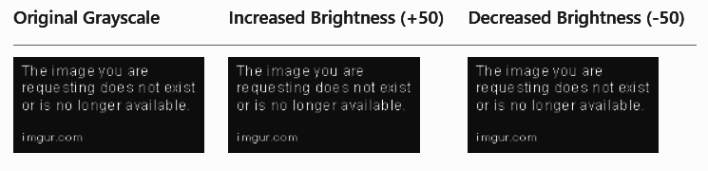
Code Output to add brightness control to grayscale images
Python script using OpenCV to add brightness control to a grayscale image using a trackbar for interactive adjustment
Example Output:
Original Grayscale Increased Brightness(+50) Decreased Brightness(-50)

Slide 27

Python Code
Hands on Code to add brightness control to grayscale images
CODE LINK

Slide 28
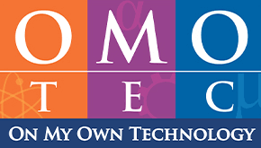
Exercise
1. What does each pixel in a grayscale image represent?
A. A matrix of RGB values B. A single intensity value C. A hexadecimal color code D. A 3-channel brightness scale
Answer: B. A Single Intensity Value
2. What does the intensity value of a pixel represent in a grayscale image? A. Image width B. Brightness level C. Color depth D. Image format
Answer: B. Brightness level

Slide 29
Exercise
Repeated Q
Answer: B
2. Which OpenCV function is used to load an image from disk?
A. cv2.display() B. cv2.show() C. cv2.imread() D. cv2.readimage()
Answer: C

Slide 30
Exercise
3. Which of the following formats uses lossless compression?
A. JPEG B. BMP C. PNG D. MP4
Answer: C
4. What does the HSV color model separate?
A. Contrast, Hue, Brightness B. Hue, Saturation, Value C. Red, Green, Blue D. Cyan, Magenta, Yellow
Answer: B

Slide 31
Exercise
5. Which function is used to draw text on images in OpenCV?
A. cv2.addText() B. cv2.label() C. cv2.putText() D. cv2.textDraw()
Answer: C
6. In OpenCV, what does cv2.convertScaleAbs() do?
A. Converts a color image to binary B. Adjusts brightness and contrast C. Detects motion in videos D. Detects facial features
Answer: B

Slide 32
Exercise
7. What is the purpose of using a trackbar in OpenCV?
A. To record video B. To switch between color models C. To adjust parameters interactively D. To load multiple images
Answer: C
8. What is the typical use of Gaussian Blur?
A. Sharpen image edges B. Increase brightness C. Smooth an image D. Add color contrast
Answer: C

Slide 33
Exercise
9. What are the RGB values for the color white?
A. (255, 255, 255) B. (0, 0, 0) C. (128, 128, 128) D. (255, 0, 255)
Answer: A
10. Which library is used to read and manipulate metadata in images?
A. Matplotlib B. NumPy C. Pillow D. TensorFlow
Answer: C

